Slide 1
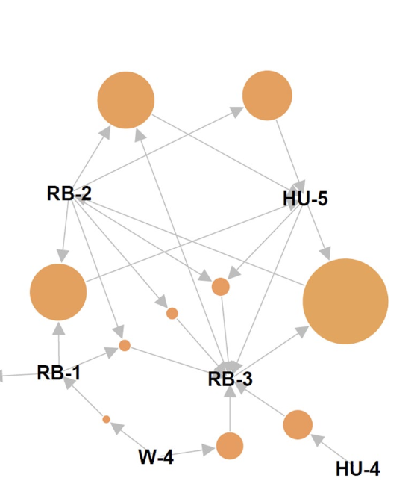
Association Rule
KEHINDE ELELU
19/NOV/2021

Slide 2
Outline:
What is Association Rule
Measurement of Association
Apriori Algorithm
Civil Engineering Application

Slide 3
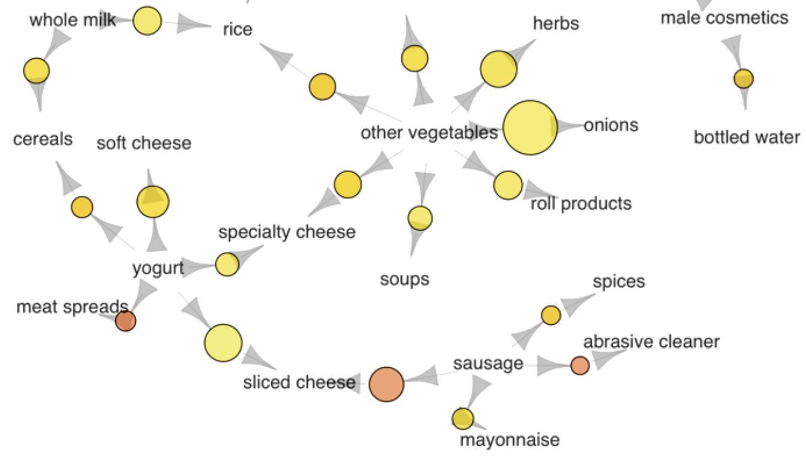
Association Rule
What is Association Rule?
Association rule is a rule-based machine learning method for discovering interesting relations between variables in large databases. It is intended to identify strong rules discovered in databases using some measures of interestingness.
The aim of association rule is frequent/interesting patterns, associations, correlations or causal structure among sets of item or elements in the database.
It is commonly used for the determination of hidden
patterns and relationships between the variables
in datasets and the dependencies among these variables.

Slide 4
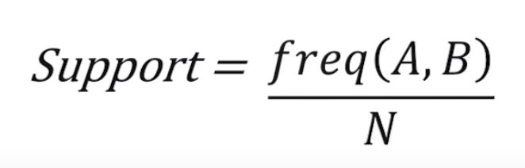
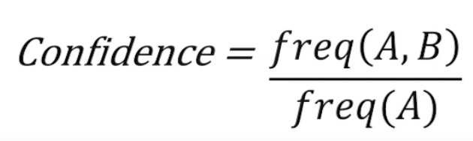
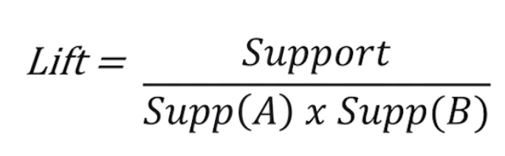
Association Rule
Measure of interest are:
Support: the occurring frequency of the rule, both transaction that contain both A and B.
2. Confidence: the strength of the association, measure of how item in B appear in transaction that contain A
3. Lift: is a measure of importance of a rule.
A lift value greater than 1 indicates that the A and the B appear more often together than expected.
A lift smaller than 1 indicates that the A and the B appear less often together than expected.
A lift value near 1 indicates that the rule body and the rule head appear almost as often together as expected.

Slide 5
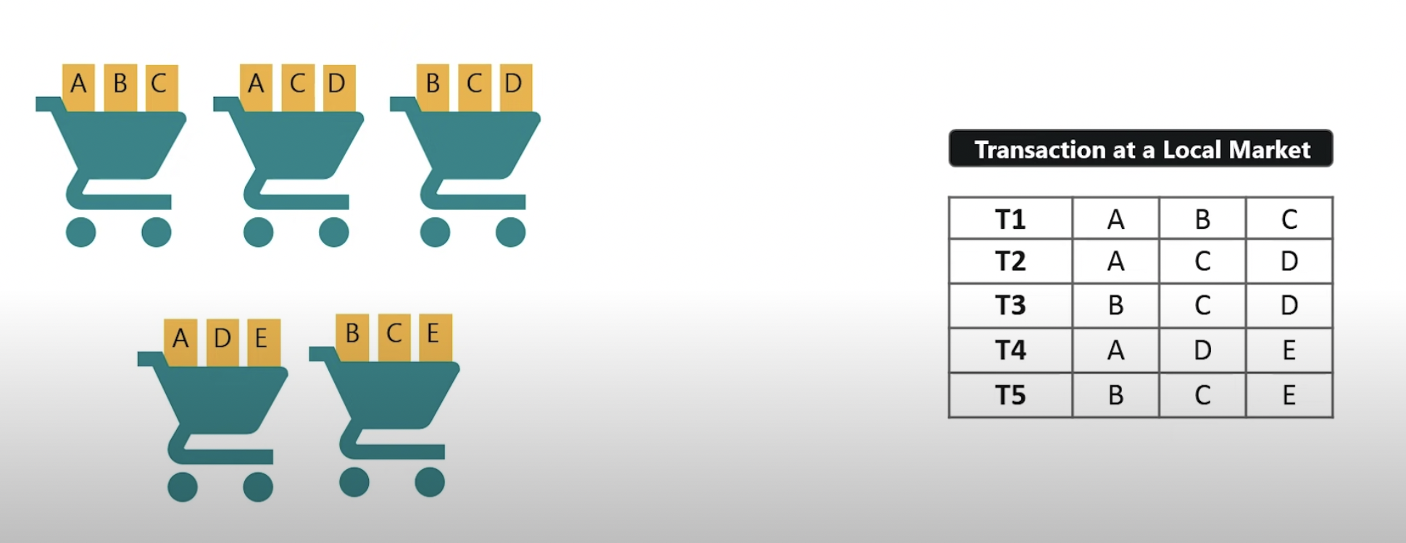
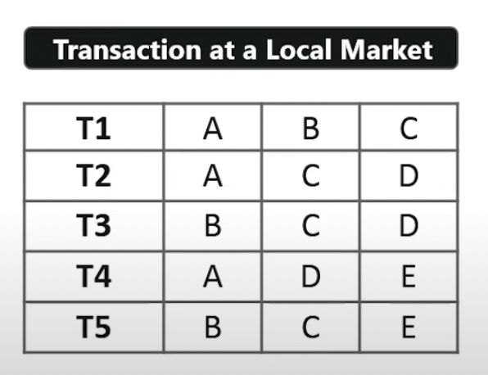
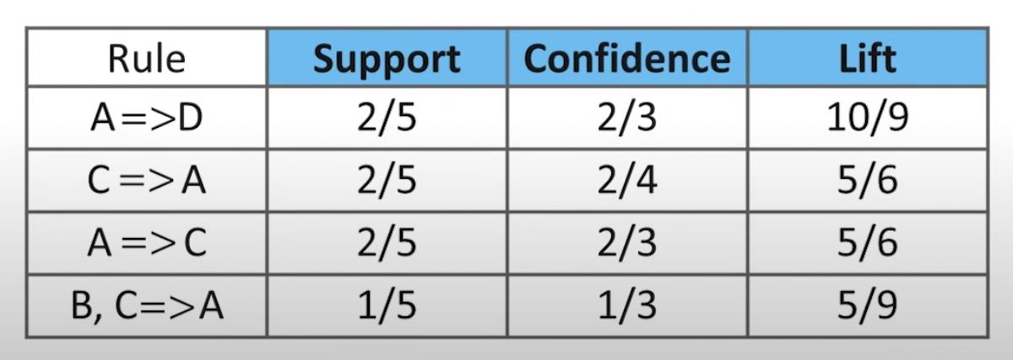
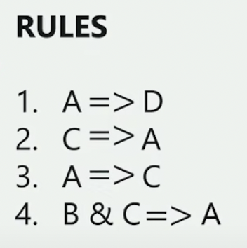
Each transaction is like a cart, this indicate the item bought by each customer
Transaction is like a cart
Transaction 1 to 5 with Item-set
Rules are build by associating with item are bought with each other and we calculate the confidence, support and lift using the formula provided above
Rules
Measures of interest are calculated using the rules

Slide 6
Apriori Algorithm
Apriori Algorithm employs an iterative approach known as a level wise search where k-itemset are used to explore (k+1) itemset
minimum support count is 2 minimum confidence is 60%
TID | items
I1,I2 | 4
I1,I3 | 4
I1,I4 | 1
I1,I5 | 2
I2,I3 | 4
I2,I4 | 2
I2,I5 | 2
I3,I4 | 0
I3,I5 | 1
I4,I5, | 0
TID | items
T1 | I1,I2,I5
T2 | I2,I4
T3 | I2,I3
T4 | I1,I2,I4
T5 | I1,I3
T6 | I2,I3
T7 | I1,I3
T8 | I1,I2,I3,I5
T9 | I1,I2,I3
itemset | Sup_count
I1,I2 | 4
I1,I3 | 4
I1,I5 | 2
I2,I3 | 4
I2,I4 | 2
I2,I5 | 2
itemset | Sup_count
I1 | 6
I2 | 7
I3 | 6
I4 | 2
I5 | 2
itemset | Sup_count
I1,I2,I3 | 2
I1,I2,I5 | 2
K3
L1
L1
K1
K2

Slide 7
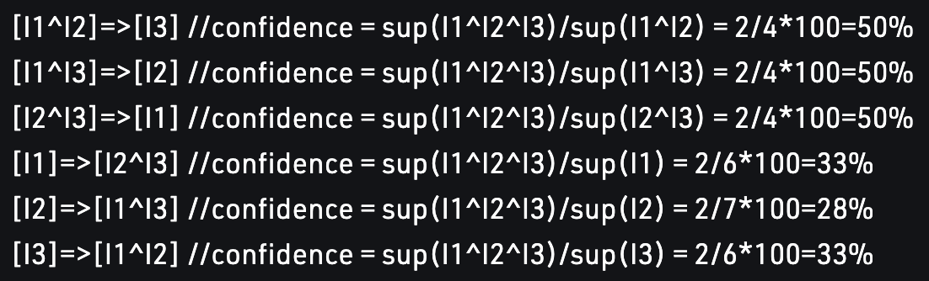
Apriori Algorithm
Rule can be calculated as:
So if minimum confidence is 50%, then first 3 rules can be considered as strong association rules.
Limitation:
Time required to hold a vast number of candidate sets with much frequent itemset.
Memory capacity is limited with large number of transactions.
Adaptive nature of the algorithm.

Slide 8
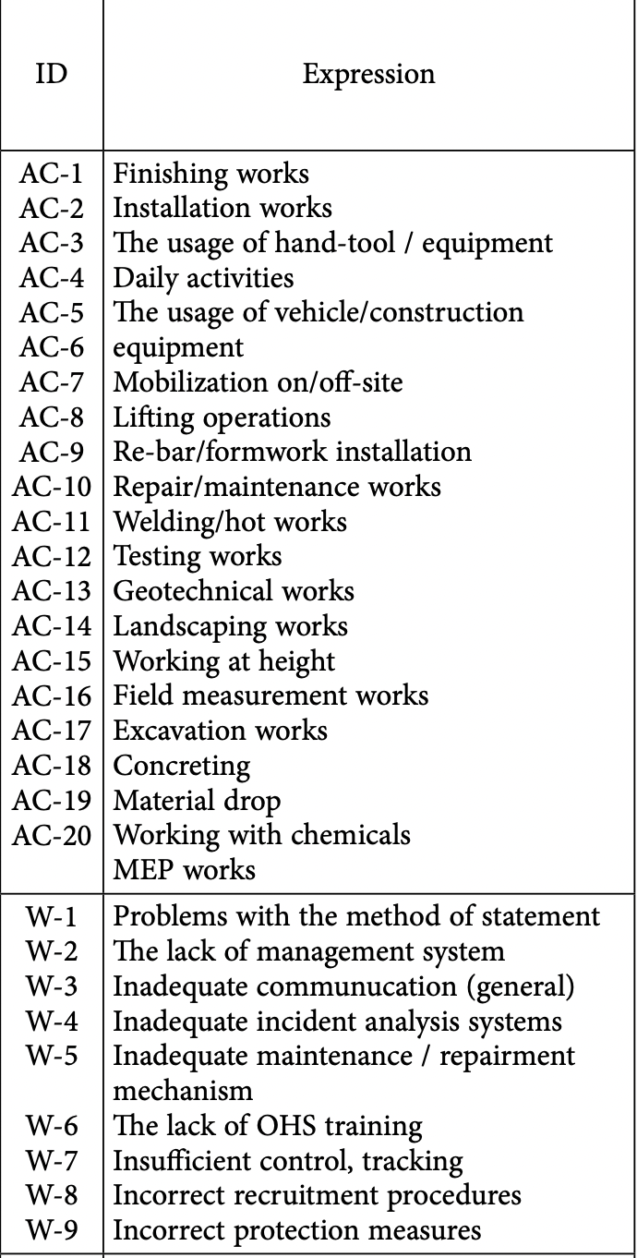
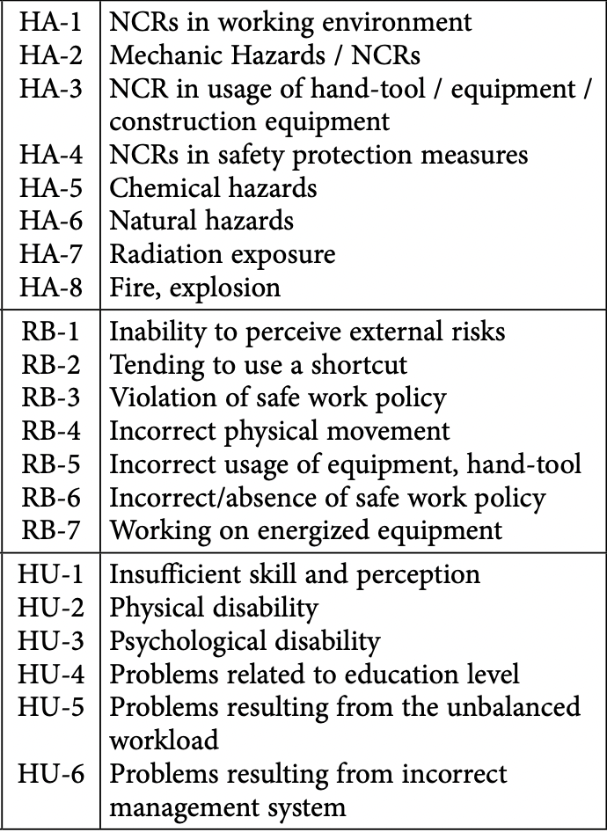
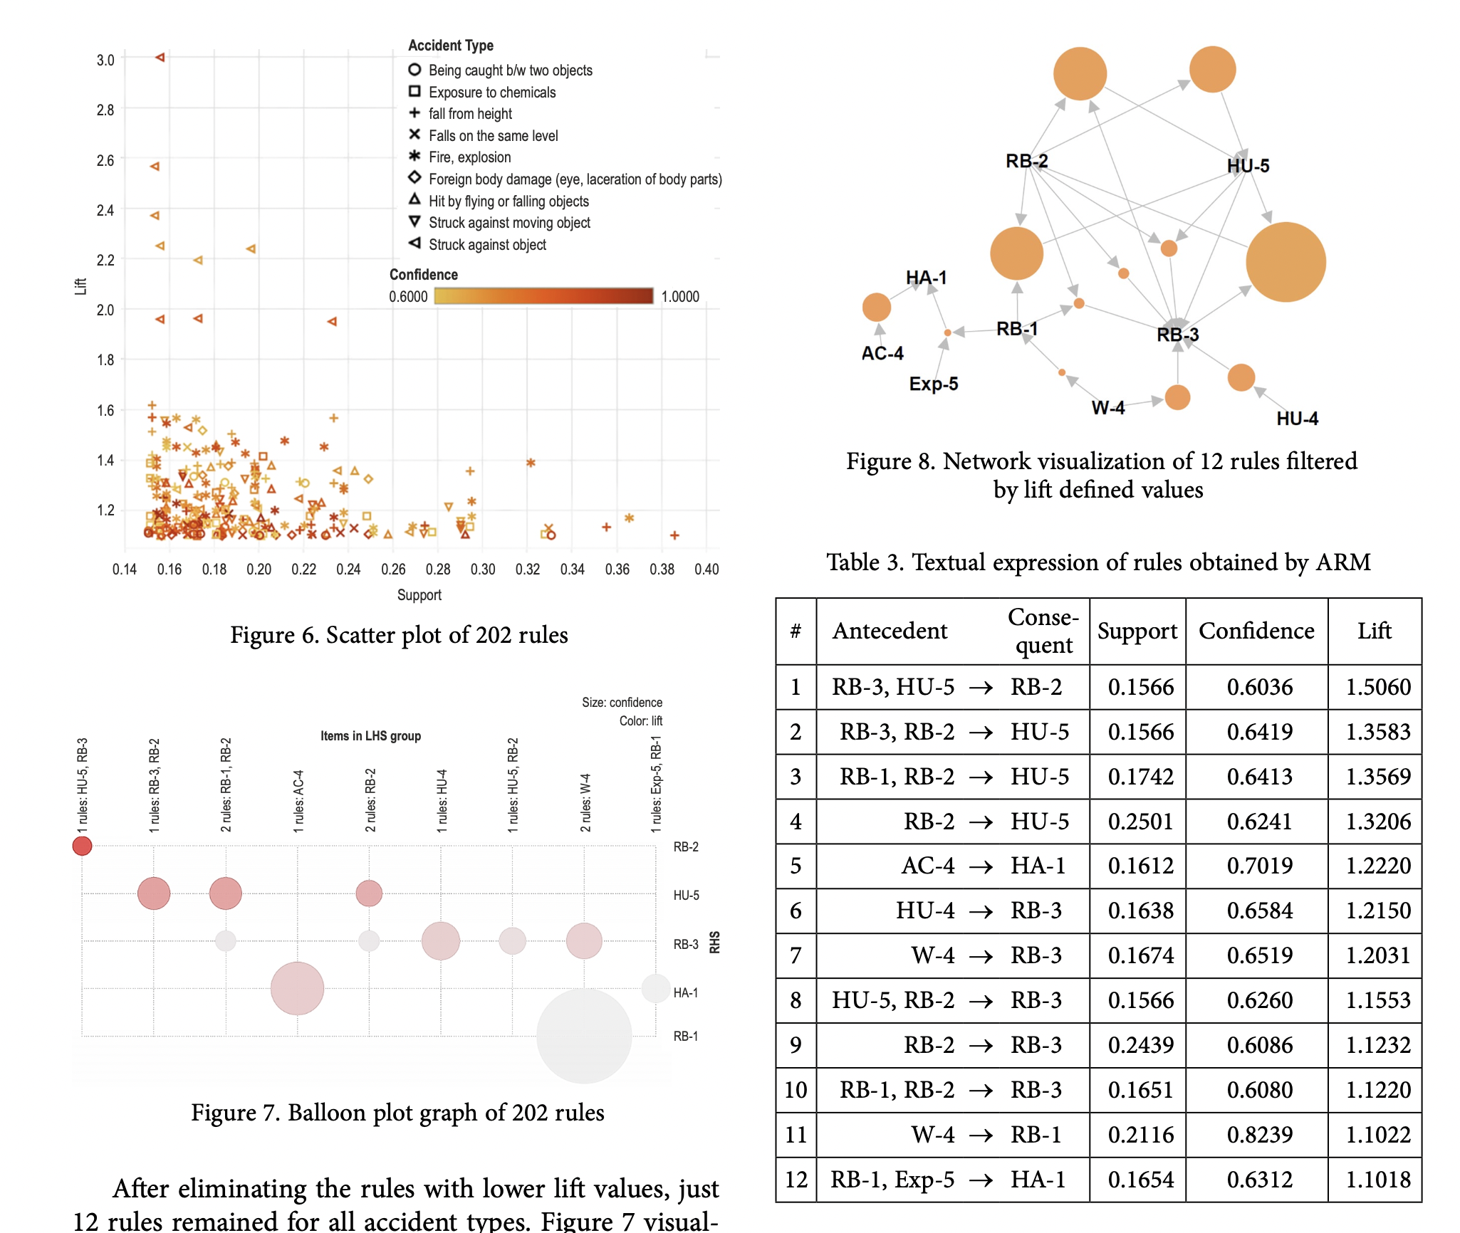
Example of its application in Civil Engineering
Research on AN ASSOCIATION RULE MINING MODEL FOR THE ASSESSMENT OF THE CORRELATIONS BETWEEN THE ATTRIBUTES OF SEVERE ACCIDENTS

Slide 9
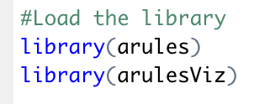
Civil Engineering Application to determine the major cause of Road Accident from road Data in Arizona
The following step are involve;
Load the data set into R
Install and load the following library
Use Apriori to calculate the number of. Rules.
Condition set while using apriori are:
minlen=2, maxlen=3, Support=0.7, coefficient=0.8

Slide 10
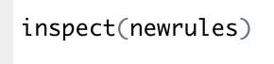
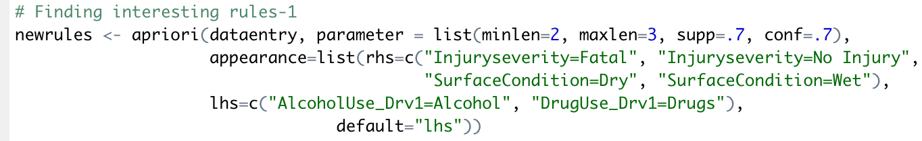
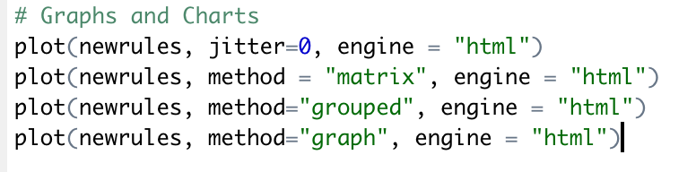
Civil Engineering Application to determine the major cause of Road Accident from road Data in Arizona
Inspect the newrules created using → inspect(newrules)
The Apriori function is run several times to find interesting rules and pattern from the data.
Visual the rules to show the relationship between different attribute from the data set.

Slide 11
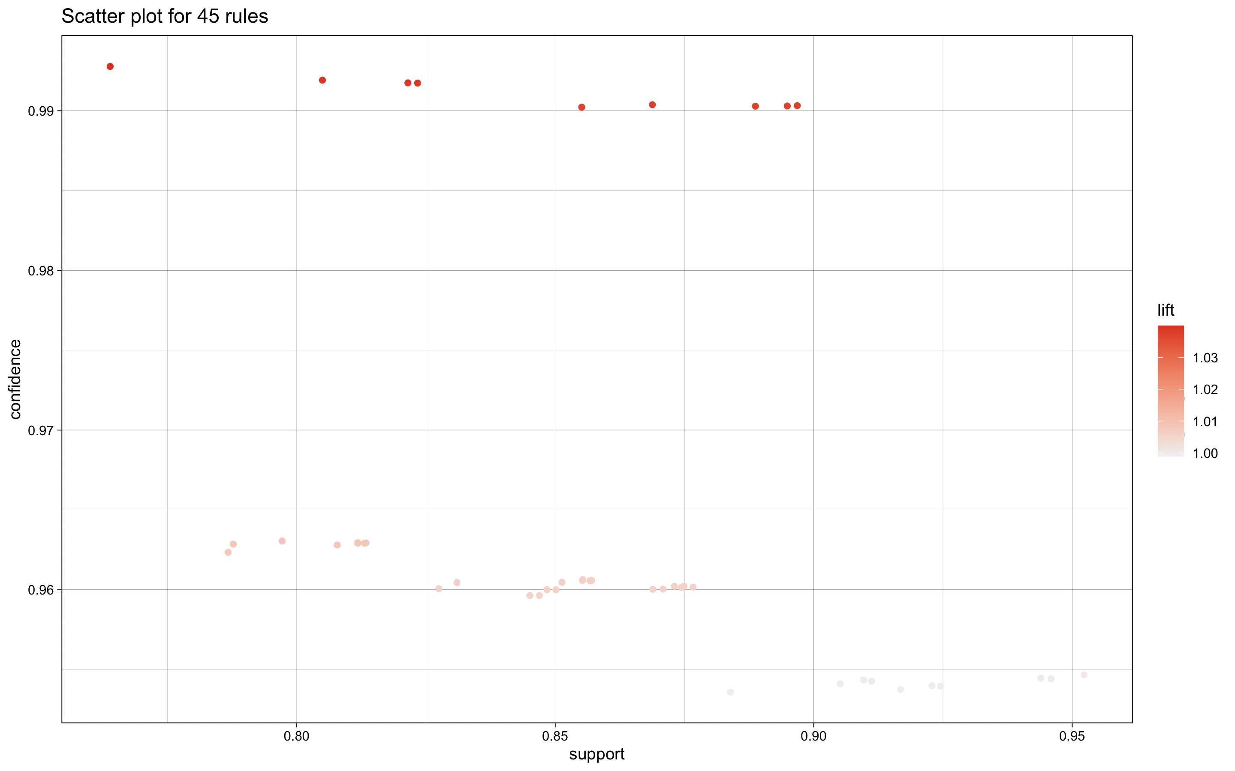
Civil Engineering Application to determine the major cause of Road Accident from road Data in Arizona

Slide 12
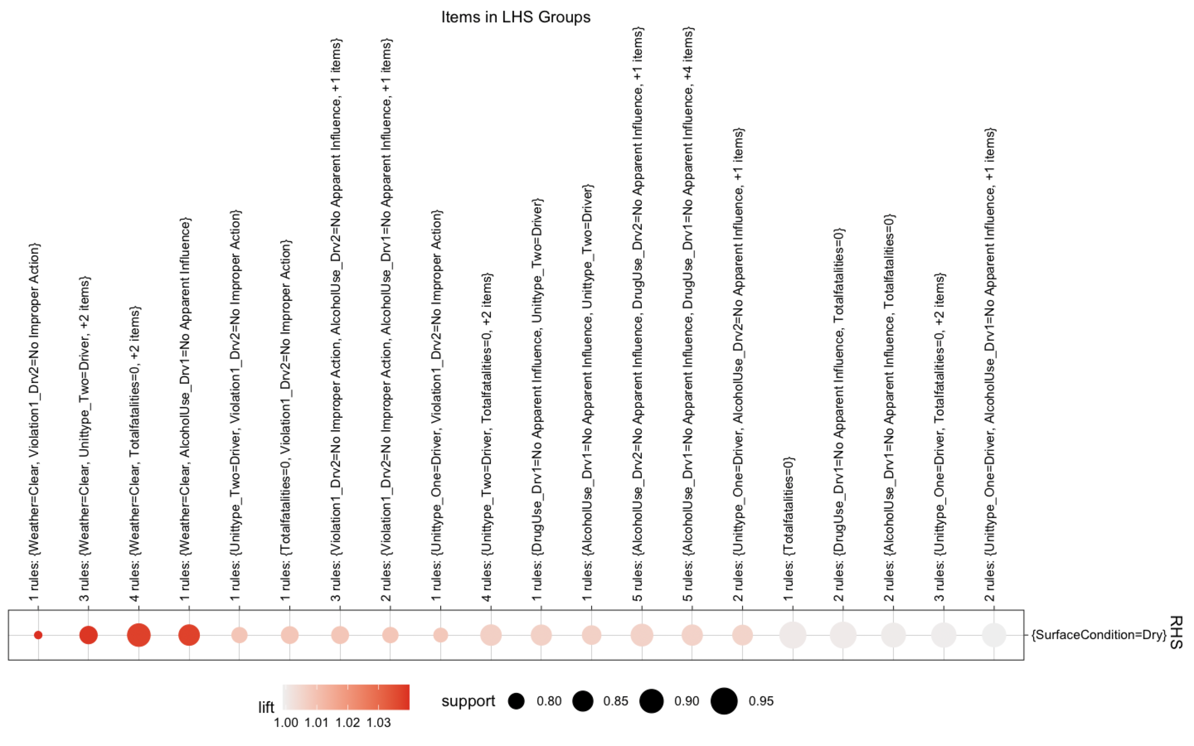
Civil Engineering Application to determine the major cause of Road Safety

Slide 13
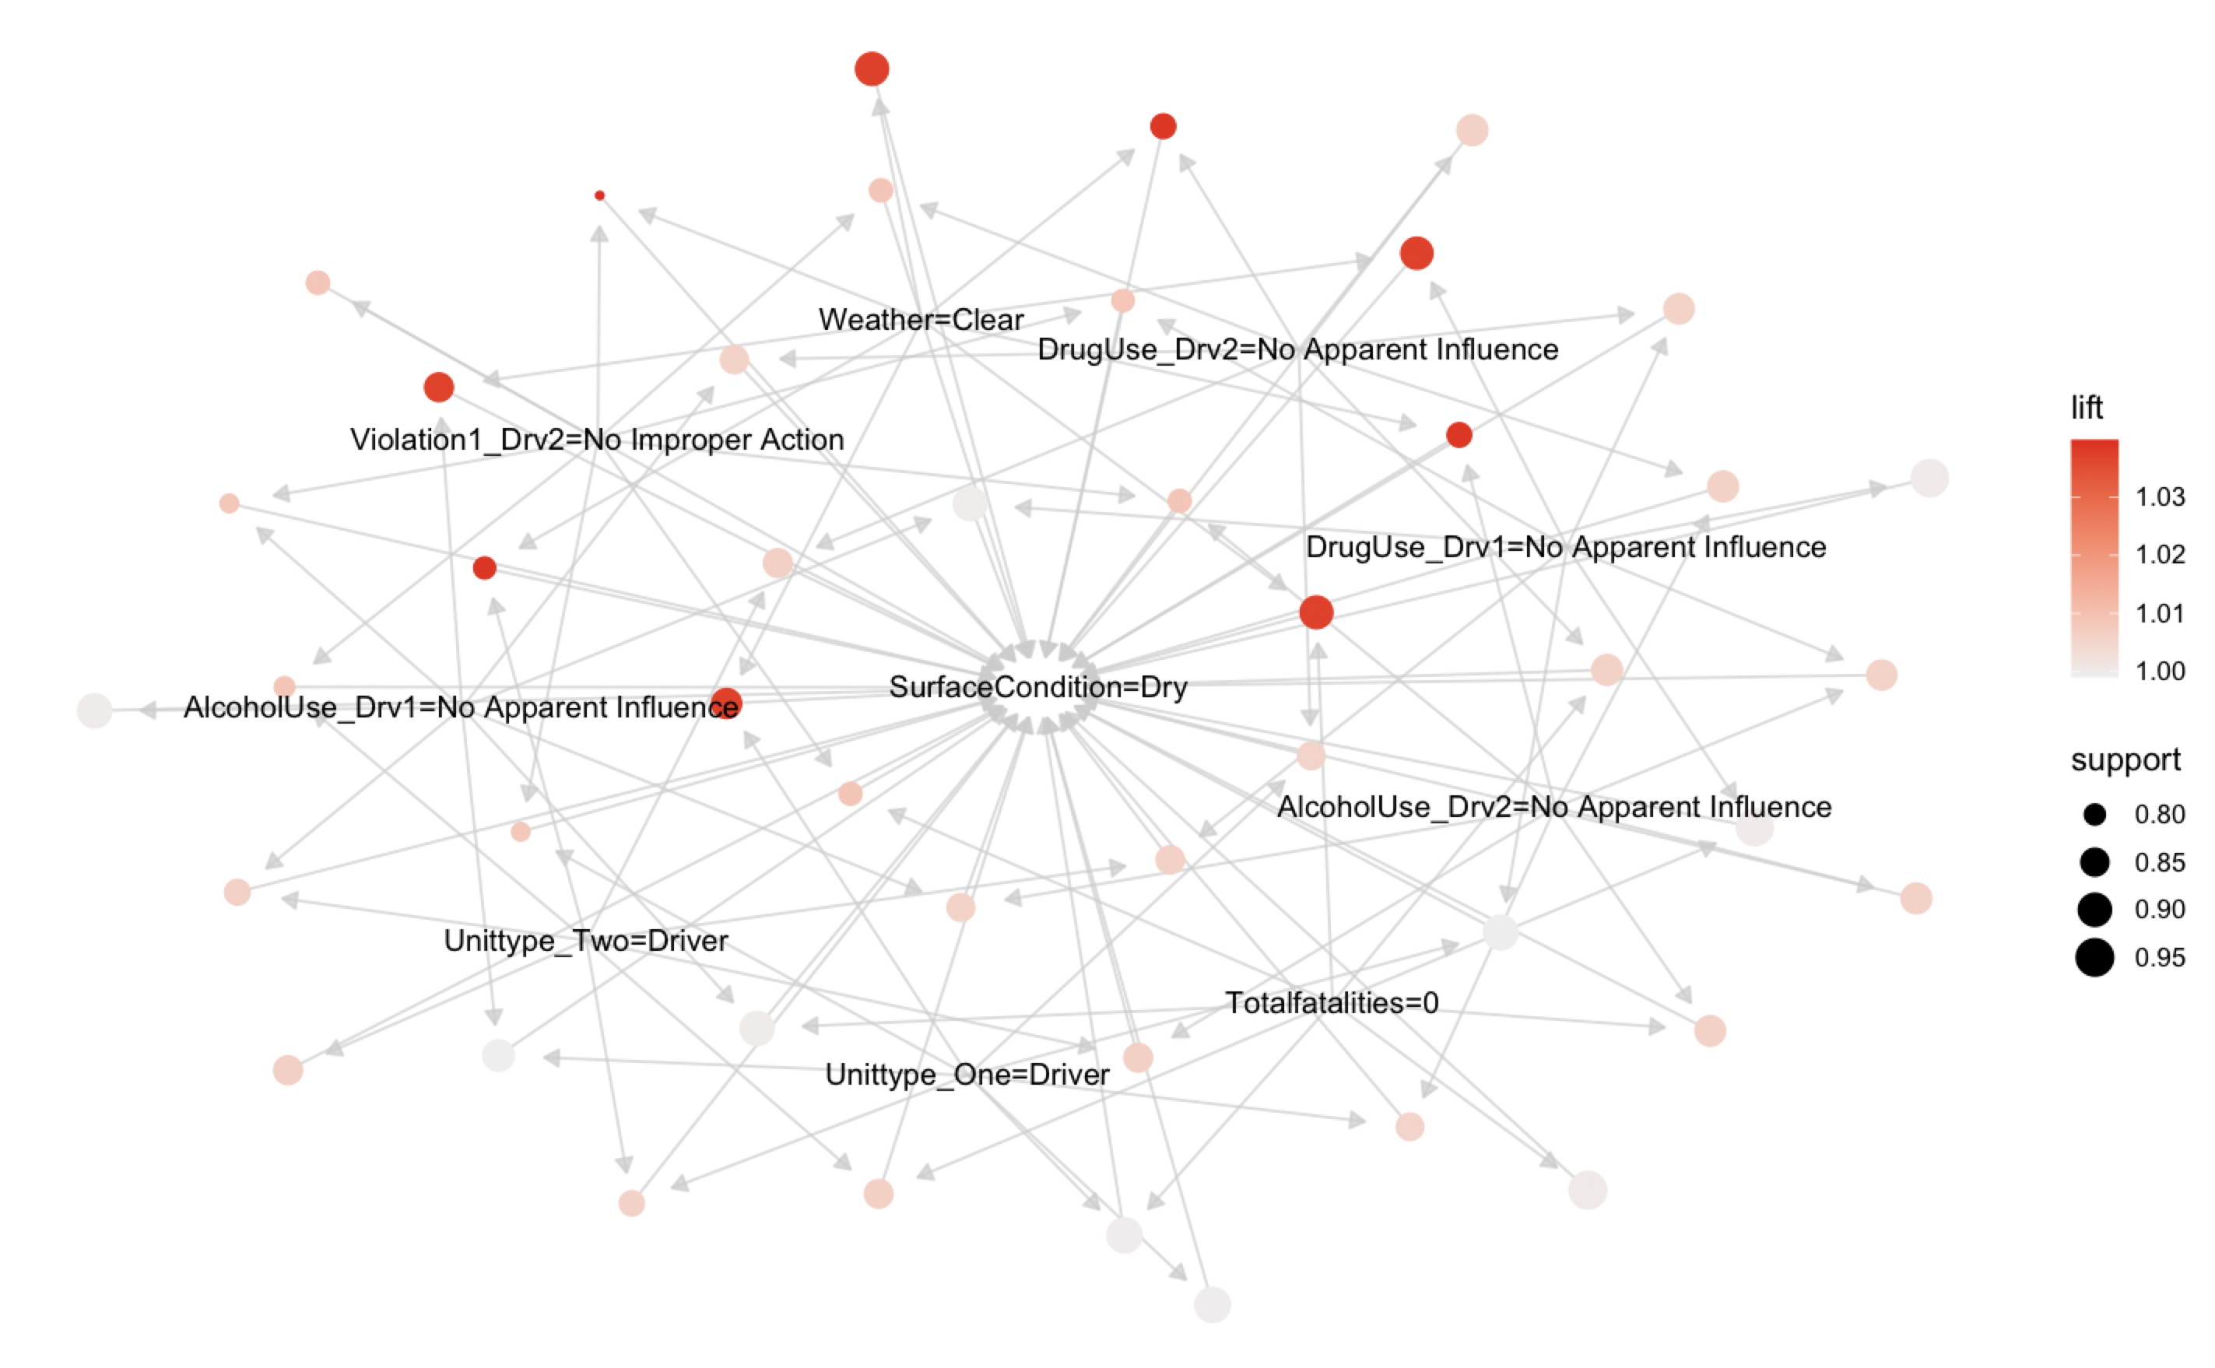
Civil Engineering Application to determine the major cause of Road Safety – 45 Rules

Slide 14
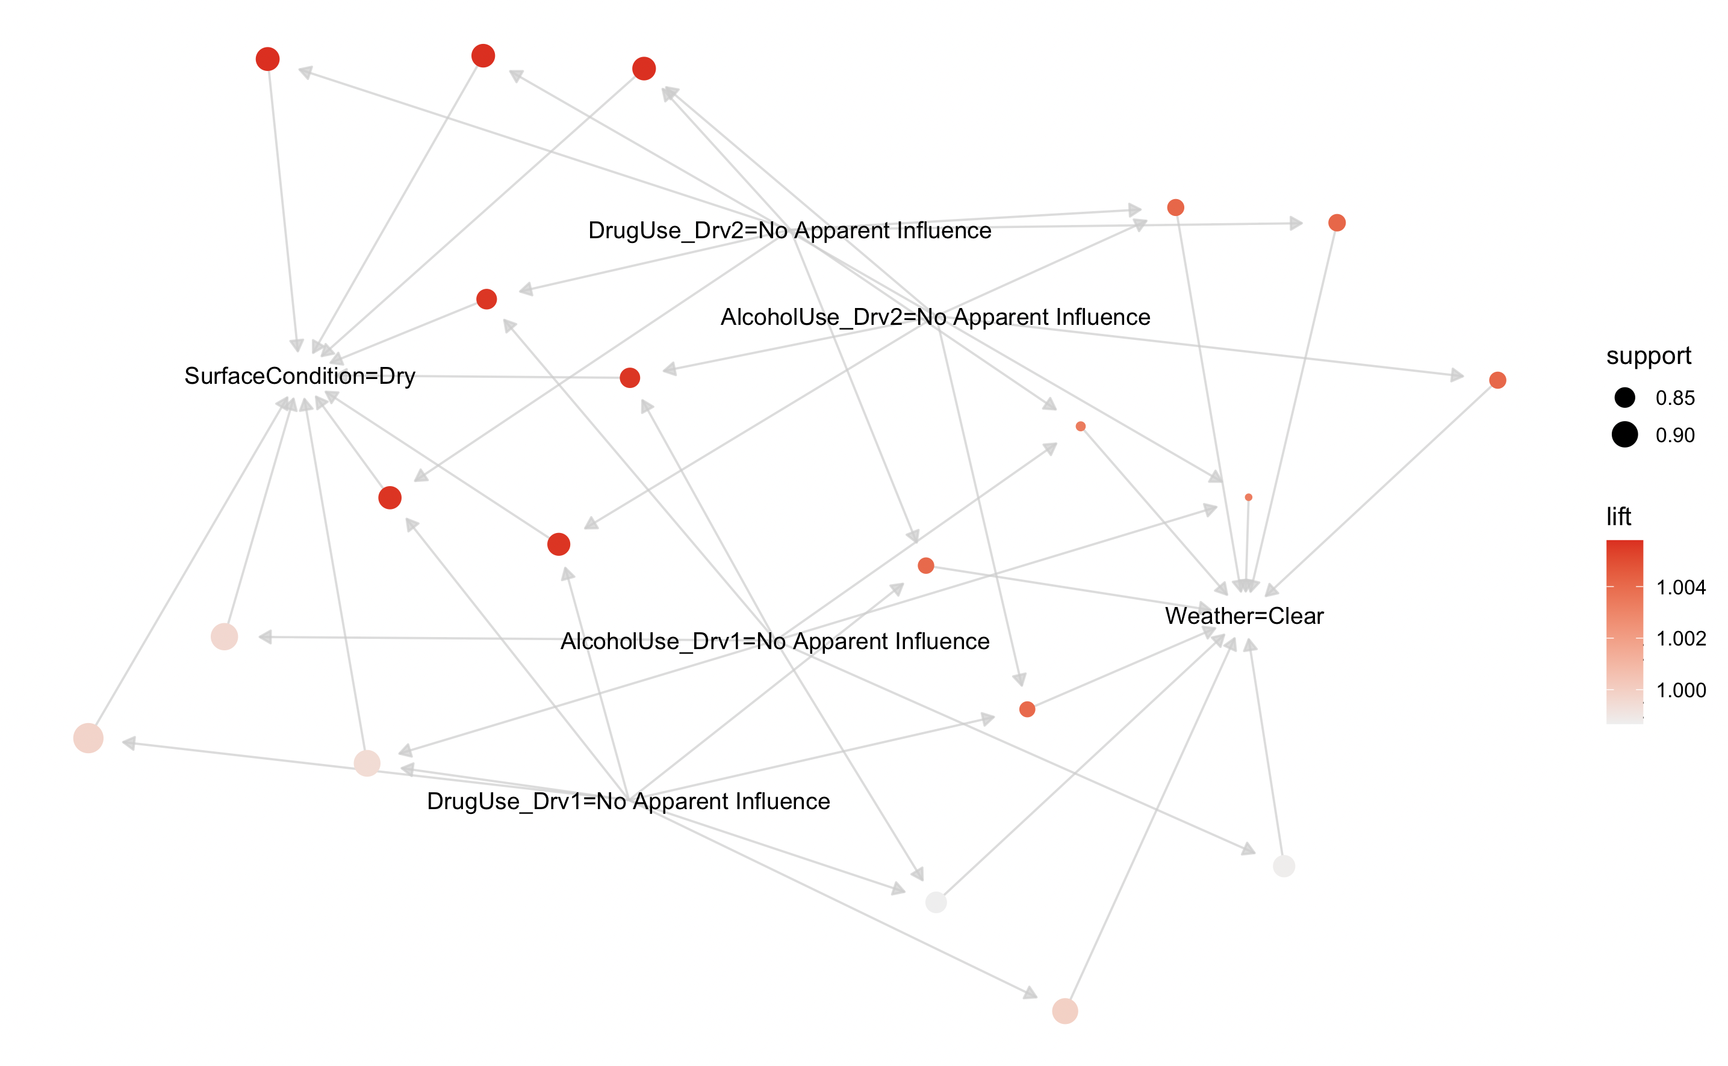
Civil Engineering Application to determine the major cause of Road Safety – 20 Rules

Slide 15
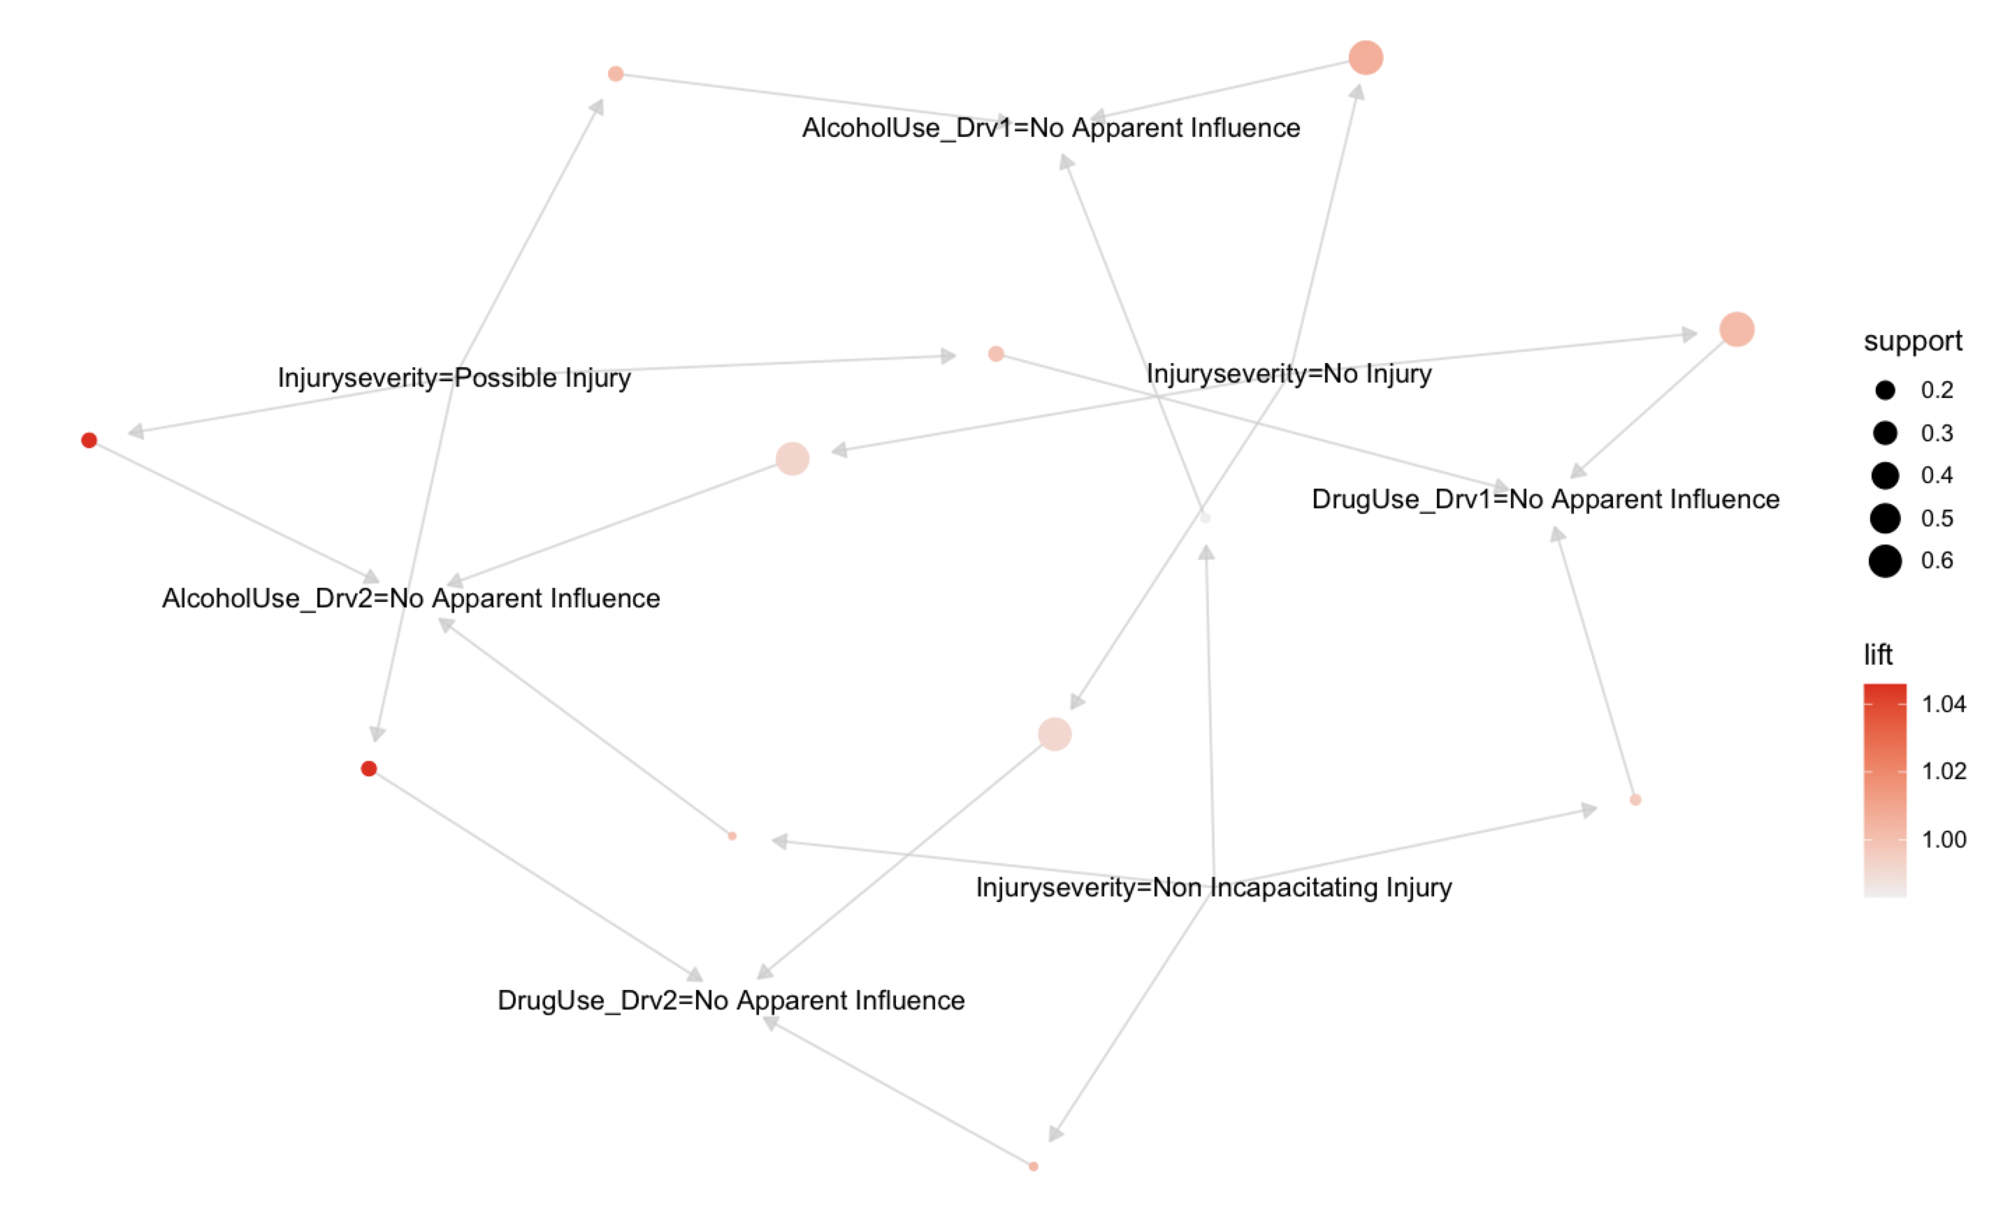
Civil Engineering Application to determine the major cause of Road Safety – 12 Rules

Slide 16
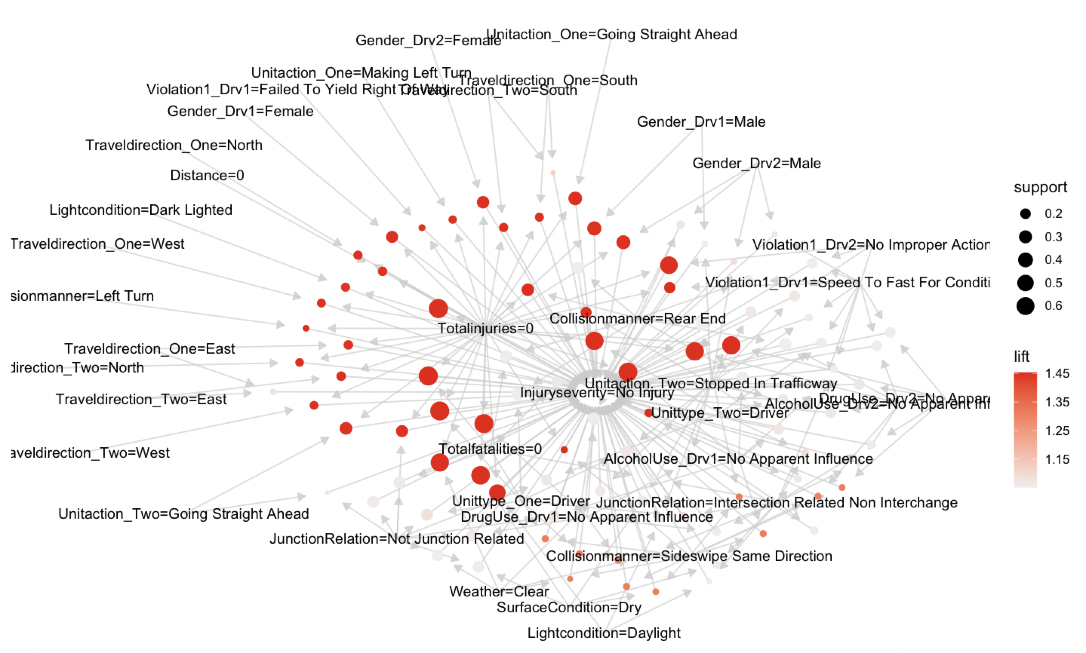
Civil Engineering Application to determine the major cause of Road Safety – 151 Rules

Slide 17
Reference:
https://www.ibm.com/docs/en/db2/9.7?topic=associations-support-in-association-rule
https://www.youtube.com/watch?v=guVvtZ7ZClw&t=265s
https://www.slideshare.net/zafarjcp/data-mining-association-rules-basics
https://www.youtube.com/watch?v=h_l3b2CIQ_o
https://www.geeksforgeeks.org/apriori-algorithm/
https://searchbusinessanalytics.techtarget.com/definition/association-rules-in-data-mining
https://catalog.data.gov/dataset?tags=crash

Slide 18

THANK YOU

